Slide 1

Research studies
~SMART LIBRARY SYSTEM
Notes:
NOTE:
To change the image on this slide, select the picture and delete it. Then click the Pictures icon in the placeholder to insert your own image.

Slide 2
LINKS
“Leveraging Artificial Intelligence for Sustainable Knowledge Organisation in Academic Libraries”
Authors: Madireng Monyela & Adeyonka Tella (2024) Focus: AI’s role in sustainable knowledge organization, metadata enrichment, automation, and ethical governance in academic libraries
https://journals.co.za/doi/full/10.7553/90-2-2396?utm_source=chatgpt.com
2. “A Review of Artificial Intelligence Implementation in Academic Library Services” Authors: Zondi, Epizitone, Nkomo, et al. (2024) Journal: South African Journal of Libraries and Information Science Focus: Adoption drivers and challenges in AI implementation within academic library settings
https://journals.co.za/doi/10.7553/90-2-2399?utm_source=chatgpt.com

Slide 3
LINKS
3. “Integrating AI into Library Systems: A Perspective on Applications and Challenges” Conference: ACM/IEEE Joint Conference on Digital Libraries (2024) Focus: Review of AI in recommendation systems, retrieval, cataloguing, chatbots, and OCR, along with future directions and challenges
https://dl.acm.org/doi/10.1145/3677389.3702568?utm_source=chatgpt.com
4. “Artificial Intelligence in Library Services: Enhancing Access, Operational Efficiency, and User Experience” Authors: Nitha Satheesh, V. A. Rinsey Antony, Seethalakshmy Anantharaman, et al. (2024) Journal: Library Progress International Focus: AI applications across cataloguing, recommendation systems, virtual assistants, and predictive analytics, along with ethical implications and practical case studies
https://bpasjournals.com/library-science/index.php/journal/article/view/1524?utm_source=chatgpt.com

Slide 4
LINKS
5. “Role of AI in Modern Library Management”
Authors: Dr Leena Joshi Assistant Library Professional IIM Indore
Year: April – June (2025)
Link: https://ijarmt.com/index.php/j/article/view/179/119
6. “Artificial Intelligence based Classification and Recommendation System for Digital Libraries” Authors: Abdulaziz I. Alomran, Imtiaz Basha Saudi Arabia Year: June (2024)
Link: https://scpe.org/index.php/scpe/article/view/2882

Slide 5
Research on 2024 and 2025 studies
Artificial Intelligence and Machine Learning in Libraries: Transforming Information Access and Management ~Bikramaditya Barman
https://www.rgujournal.in/index.php/RGUJSSR/article/view/4?utm_source=chatgpt.com
Application of Artificial Intelligence to Transform Library Management Systems for Tailored Recommendations – A Review ~Vijay Desai & Chandrakant S.Gokhale
https://bpasjournals.com/libraryscience/index.php/journal/article/view/1365?utm_source=chatgpt.com

Slide 6
Artificial Intelligence and Machine Learning in Libraries: Transforming Information Access and Management
ABSTRACT
The rapid growth of Artificial Intelligence (AI) and Machine Learning (ML) is reshaping library management and services, offering innovative solutions to challenges in information organization, user engagement, and operational efficiency. AI technologies automate repetitive tasks such as cataloguing, metadata generation, and resource classification, reducing staff workload and ensuring accuracy. ML-driven recommendation systems further enhance user experience by delivering personalized content suggestions, while AI-powered chatbots and virtual assistants provide real-time assistance, improving accessibility. Predictive analytics enables libraries to anticipate user demand and optimize resource allocation. However, these advancements raise ethical considerations, including data privacy, algorithmic bias, and potential workforce displacement. This paper explores the current and emerging applications of AI and ML in libraries, examines real-world implementations, and discusses strategies for responsible adoption to maximize benefits while mitigating risks.

Slide 7
CONCLUSION
AI and ML are transforming libraries into intelligent, user-centric information hubs. By automating routine operations, personalizing resource recommendations, and enabling predictive decision-making, these technologies significantly enhance efficiency and accessibility. Real-world implementations demonstrate tangible improvements in cataloguing accuracy, user satisfaction, and resource management. Nevertheless, their integration must be approached with caution, ensuring transparency, ethical data practices, and ongoing staff training. Addressing concerns such as privacy, bias, and potential job displacement is essential for sustainable adoption. As AI and ML continue to evolve, libraries that embrace these technologies responsibly will be better positioned to meet the dynamic needs of their users, foster inclusive access to information, and remain relevant in the digital age.

Slide 8
Application of Artificial Intelligence to Transform Library Management Systems for Tailored Recommendations
ABSTRACT
Traditional library management systems, while effective for cataloguing and organizing resources, often fall short in delivering personalized user experiences. Their reliance on standardized classification and metadata-based search limits their ability to provide dynamic, user-specific recommendations, resulting in static and less engaging interactions. The dependence on librarian-mediated assistance, though valuable, lacks scalability and cannot consistently deliver real-time, tailored guidance. With growing demand for user-centric services, libraries are increasingly adopting Artificial Intelligence (AI) technologies—particularly Machine Learning (ML) and Natural Language Processing (NLP)—to improve resource discoverability and personalization. This paper reviews existing literature on both traditional and AI-driven library management systems, exploring how advanced algorithms and behavioural data analysis enable libraries to dynamically adapt to individual preferences, academic interests, and interaction patterns. The review also examines key implementation challenges, including data privacy concerns and resource limitations, to provide a balanced perspective on the transformative potential of AI in modern library environments.

Slide 9
CONCLUSION
The shift from traditional to AI-driven library management systems marks a pivotal step in meeting the evolving needs of modern library users. By leveraging ML and NLP, libraries can move beyond static, metadata-based search to offer dynamic, personalized recommendations that enhance user satisfaction and engagement. These technologies enable real-time adaptation to user preferences, making resource discovery more efficient and intuitive. However, successful implementation requires addressing significant challenges, including safeguarding user data, ensuring algorithmic transparency, and managing resource constraints. As libraries embrace AI-based solutions, a balanced approach that combines technological innovation with ethical and sustainable practices will be essential to maximizing benefits while preserving the core values of accessibility, equity, and trust.

Slide 10
Role of AI in Modern Library Management
ABSTRACT:
AI applies machine learning, natural language processing, and predictive analytics to recommend suitable books to readers, predict overdue returns, and provide personalized services that match user preferences and needs.
Routine library tasks such as cataloging, indexing, and classification are automated through AI, reducing manual effort, minimizing errors, and ensuring users can quickly retrieve the most relevant resources.
AI-powered chatbots offer round-the-clock assistance by answering queries and guiding users, while digital archiving with AI helps preserve rare and historical collections, contributing to sustainability in libraries.
Although challenges such as data privacy, ethical concerns, and implementation costs exist, the benefits of AI—including efficiency, cost savings, and improved user satisfaction—make it essential for building adaptive and future-ready libraries.
CONCLUSION:
Artificial Intelligence is transforming modern library management, redefining how libraries function and deliver services in the digital age. By automating repetitive tasks such as cataloging, indexing, and metadata generation, AI reduces manual workload and improves efficiency. Predictive analytics and personalization enhance user experience, while chatbots, virtual assistants, and accessibility tools ensure inclusivity for diverse communities. AI also supports digital archiving, preservation of rare collections, and optimal resource allocation. Though issues like data privacy, ethical concerns, and implementation costs remain, the advantages far outweigh the drawbacks. Libraries embracing AI become dynamic, future-ready knowledge hubs that balance tradition with technological innovation.

Slide 11
AI based Classification and Recommendation System for Digital Libraries
ABSTRACT:
AI-powered recommendation systems guide professors, students, and researchers toward suitable resources in academic and e-libraries.
Collaborative filtering is common, but it struggles with unrated or unused resources in repositories.
Techniques like Neuro-Fuzzy (NF) models and Support Vector Machines (SVM) classify large multiclass corpora stored in cloud databases.
Ensemble learning strategies enhance accuracy by combining results from multiple classifiers.
A Coherence of Content (CoC)-based mechanism filters key information, ensuring precise recommendations that improve access to relevant academic and research materials.
CONCLUSION:
The study demonstrates that Ensemble Learning (ESL)-based recommender systems significantly improve the efficiency and accuracy of digital library recommendations. By applying Coherence of Content (CoC) inference for component filtering and testing on multiple datasets, the ESL model—particularly with the Random Forest approach—achieved minimized fallout and high accuracy, averaging over 98% at an 80:20 ratio. These results confirm that ESL methodologies can effectively handle vast digital library repositories, ensuring precise, reliable, and scalable recommendations, thereby enhancing research quality and user confidence in accessing relevant information.

Slide 12
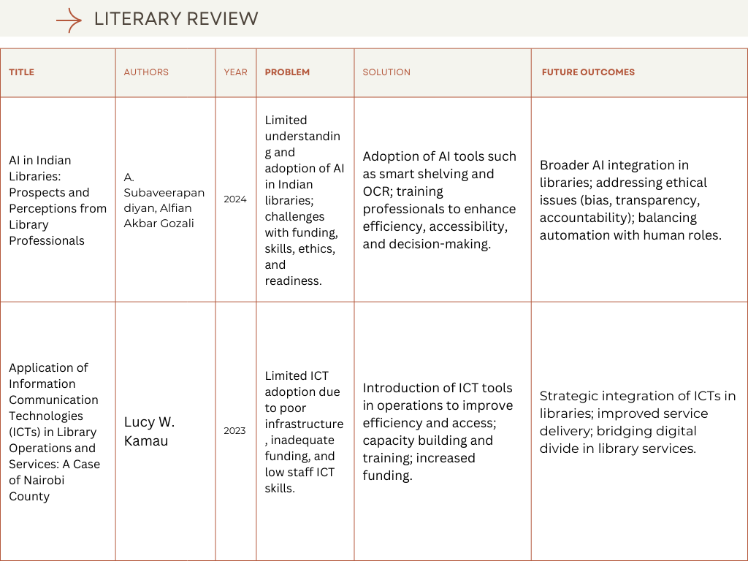

Slide 13
THANK YOU
~Medapati Harshitha Reddy

